Slide 1
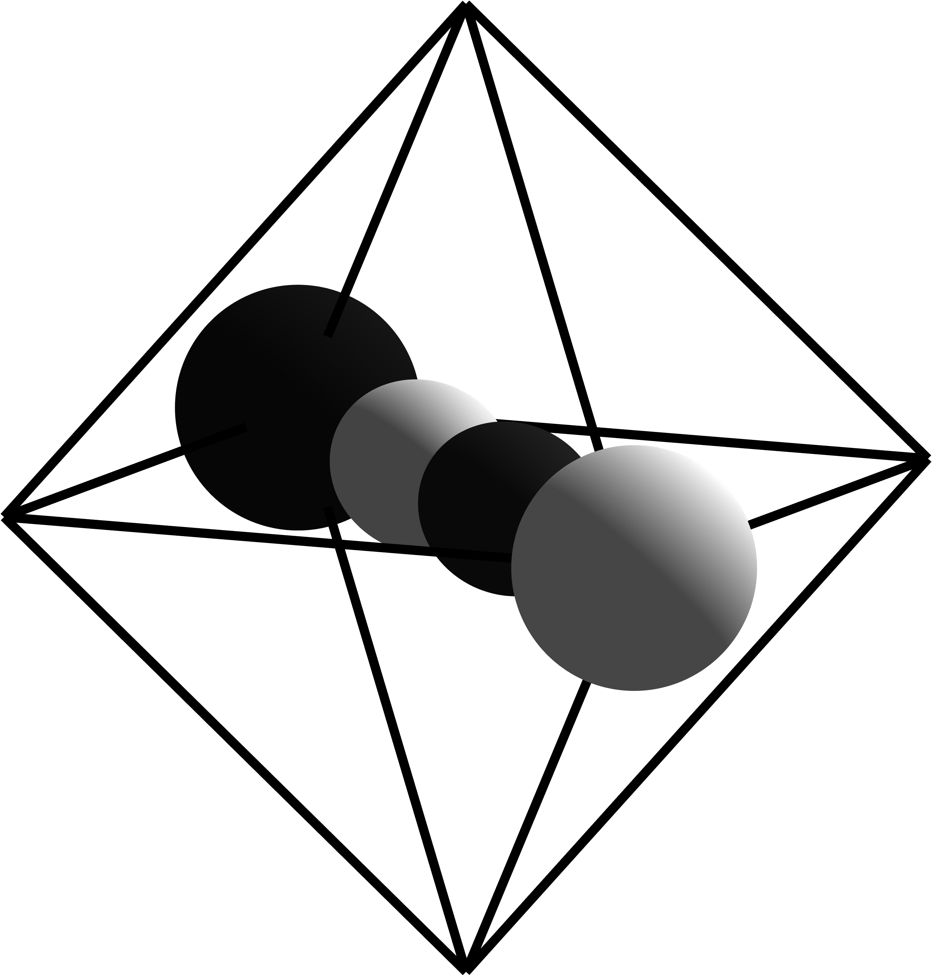
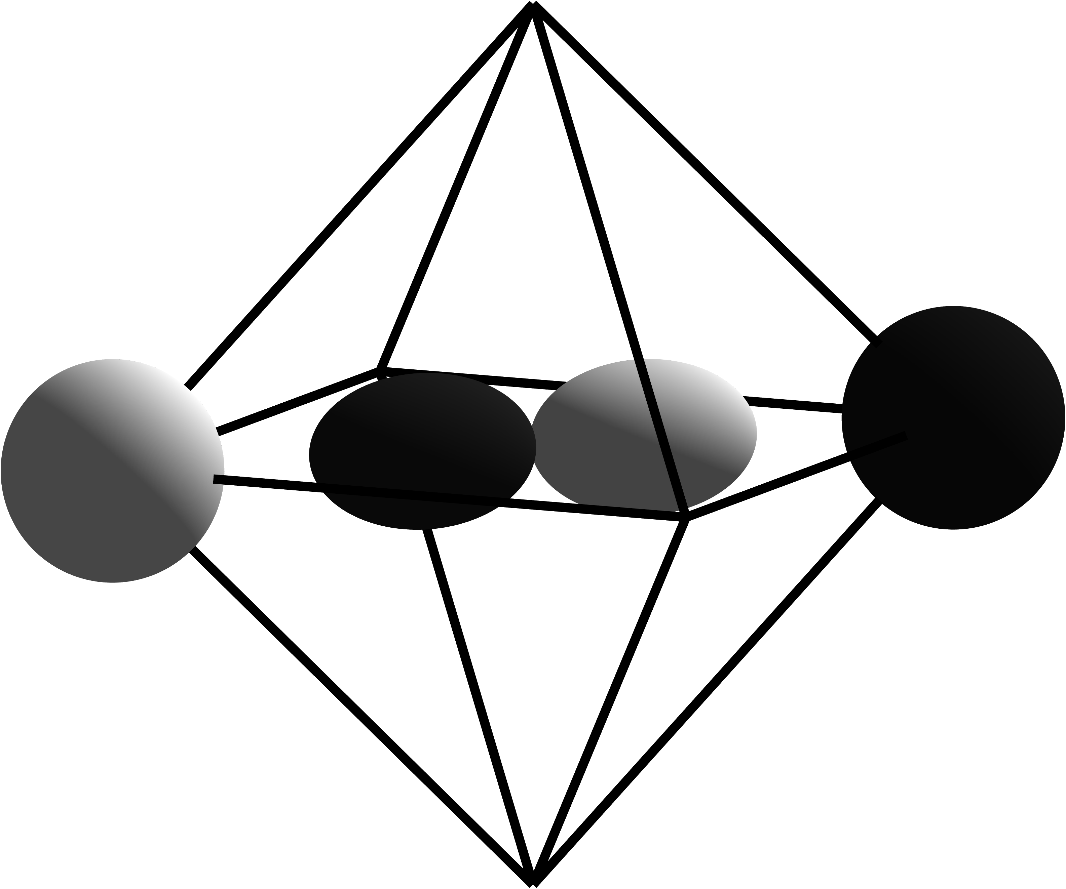
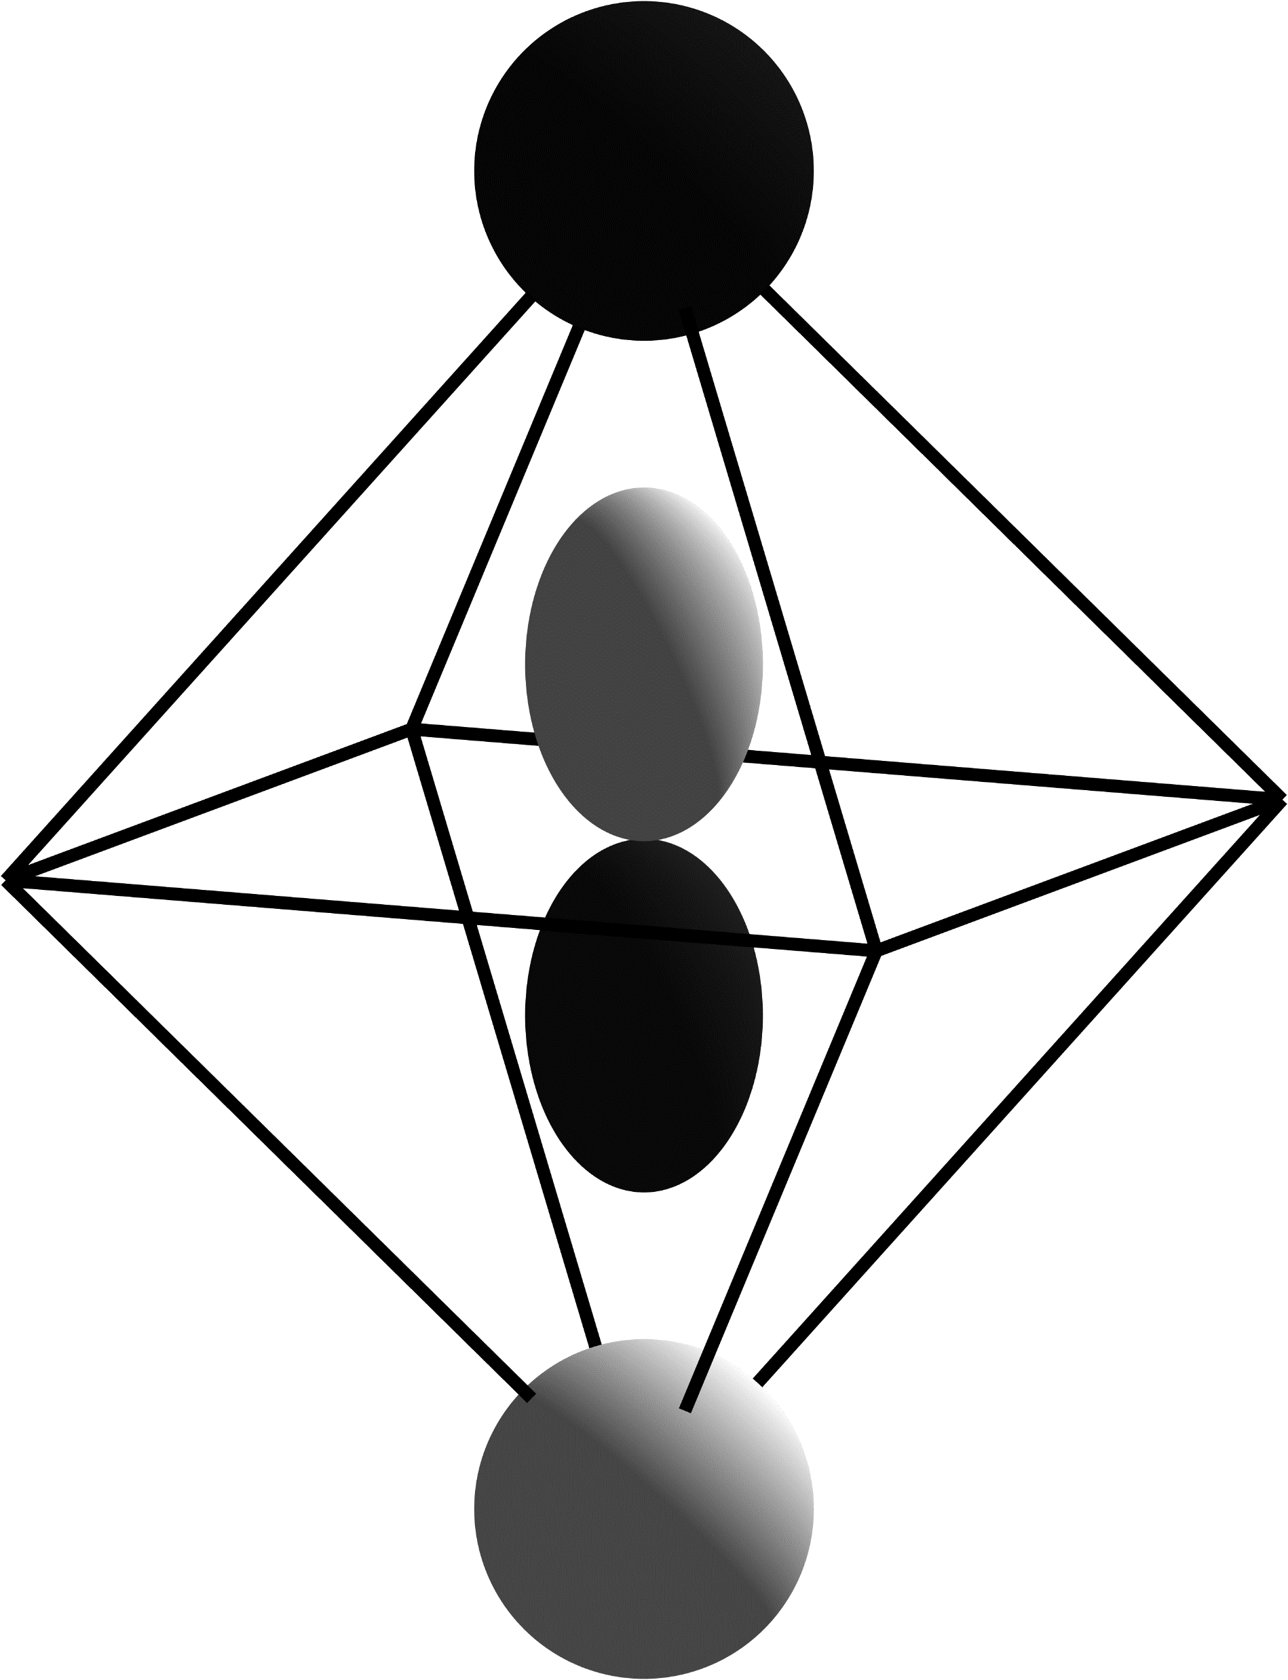
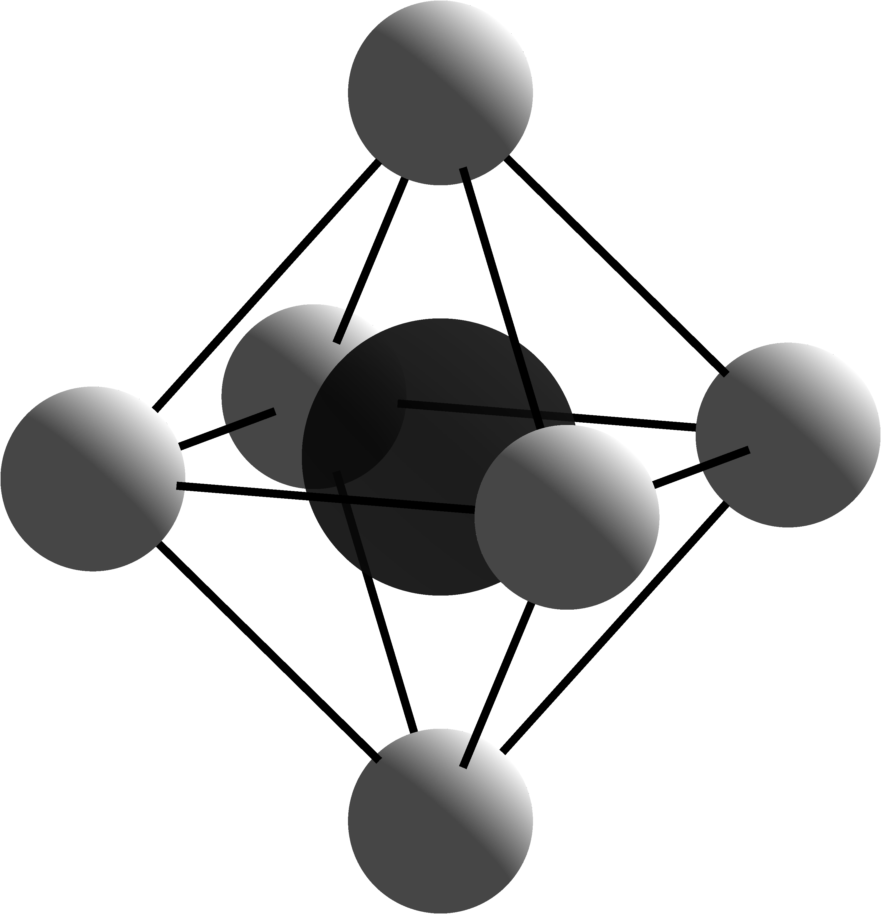
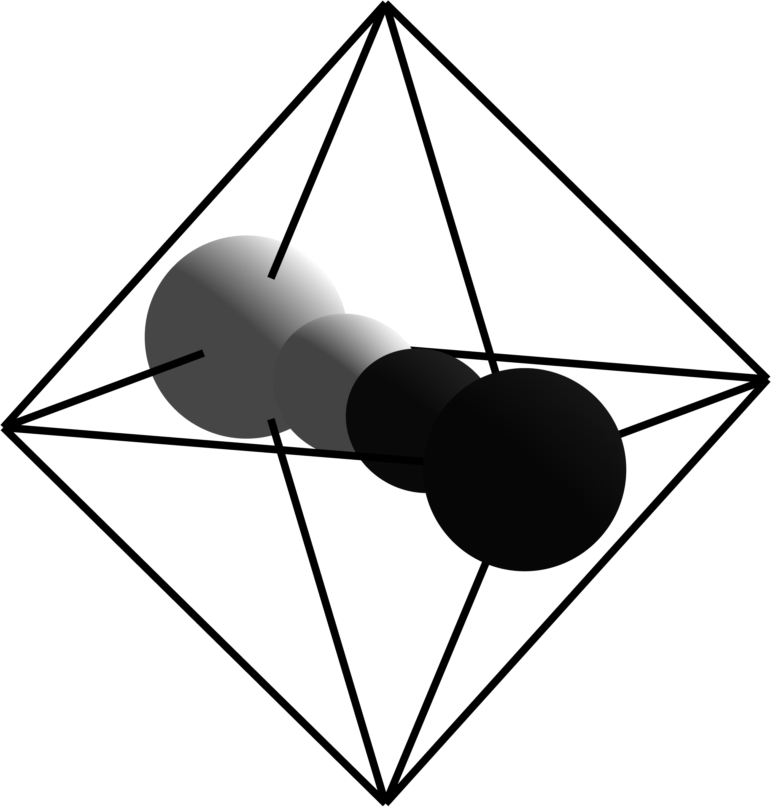
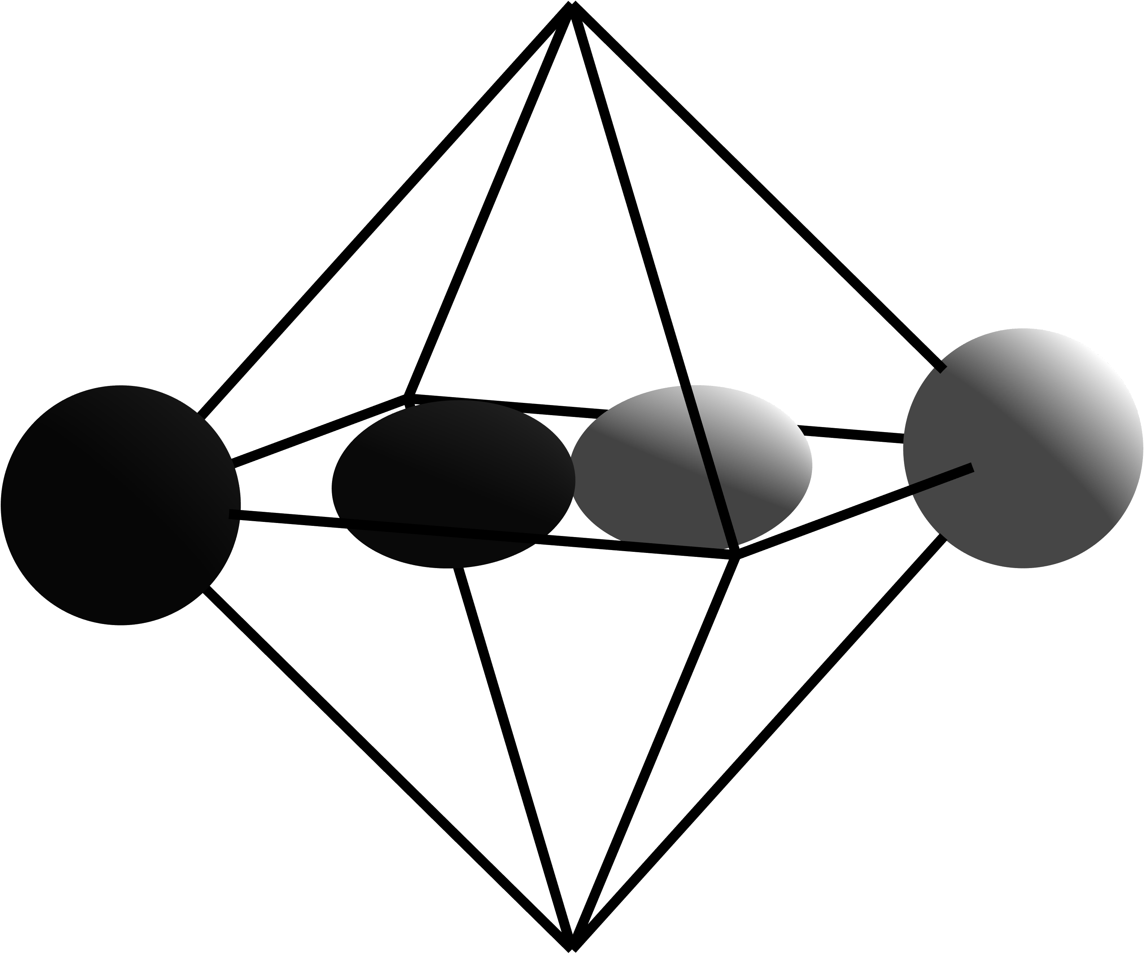
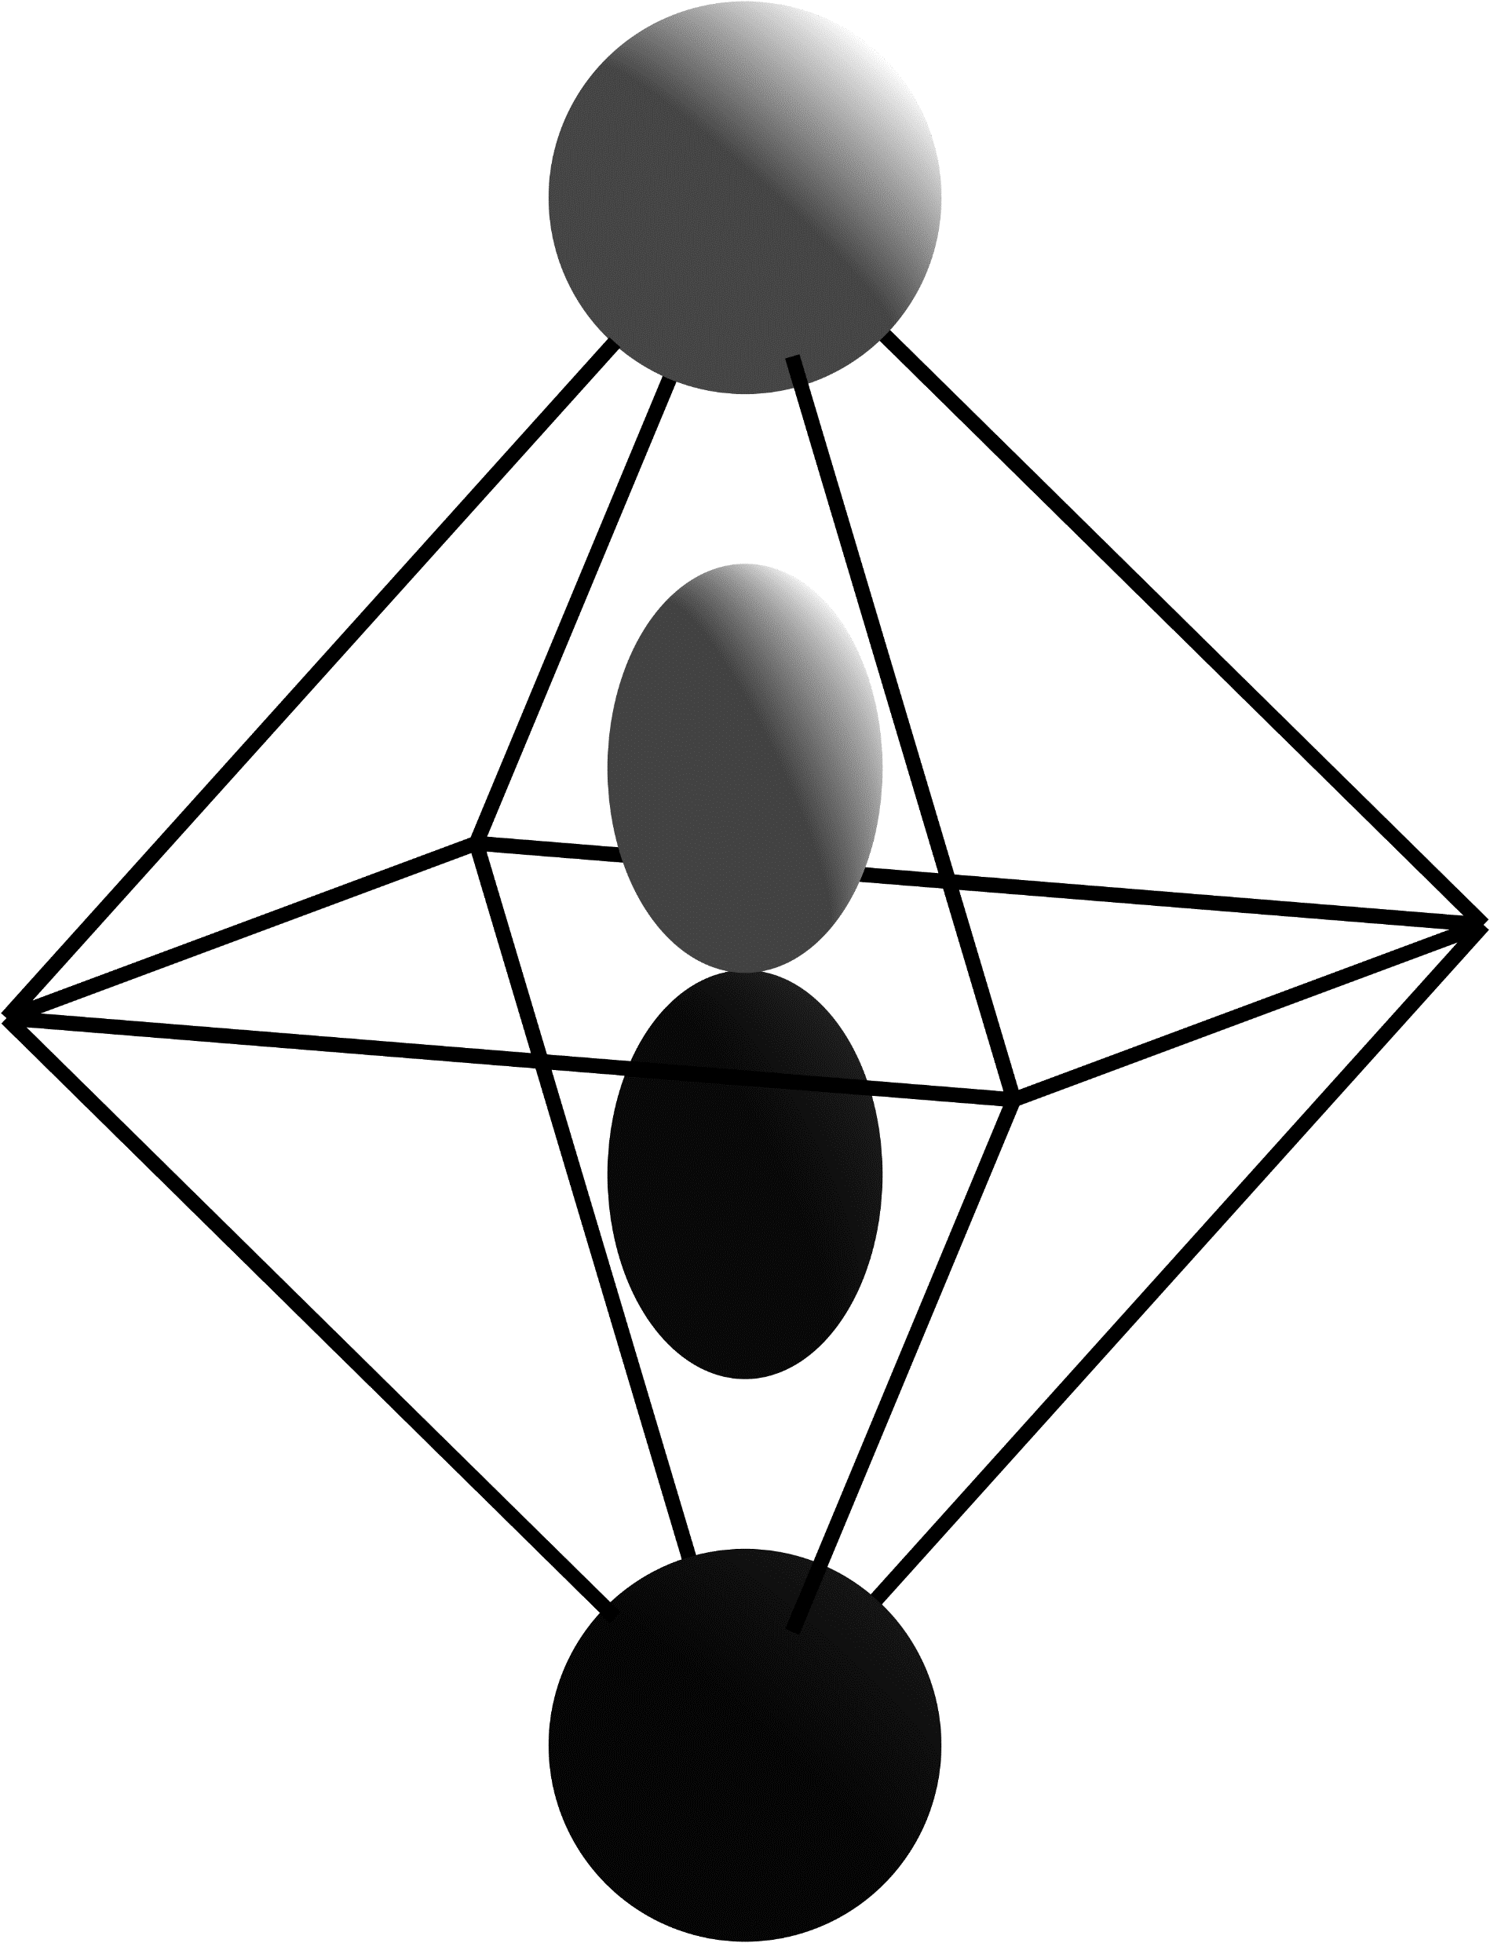
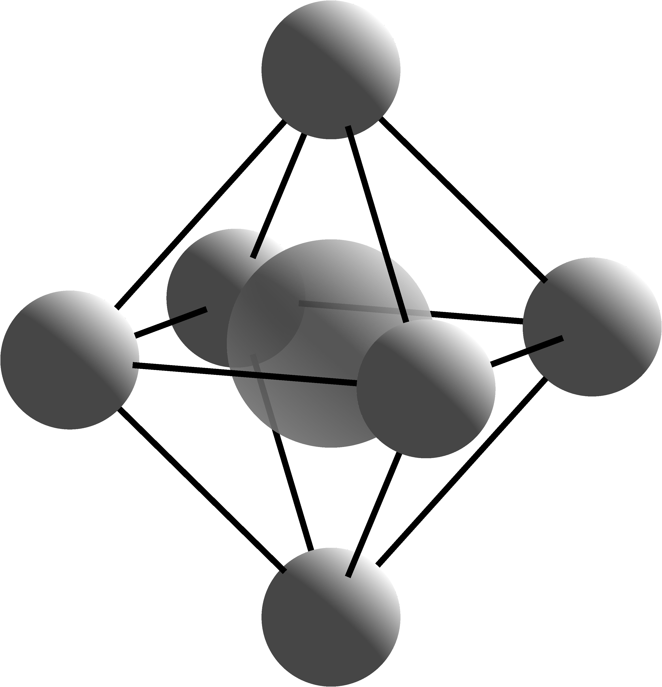
Conduction Band
E⁺
T⁻
P
1
A⁺
S
1
E_{CBM}
E_{F}
E_{VBM}
Valence Band
Notes:
Magnesium on an Oxygen site q = +2

Slide 2
Conduction Band
E⁺
T⁻
P
1
A⁺
S
1
E_{CBM}
E_{F}
E_{VBM}
Valence Band
Notes:
Magnesium on an Oxygen site q = 0

Slide 3
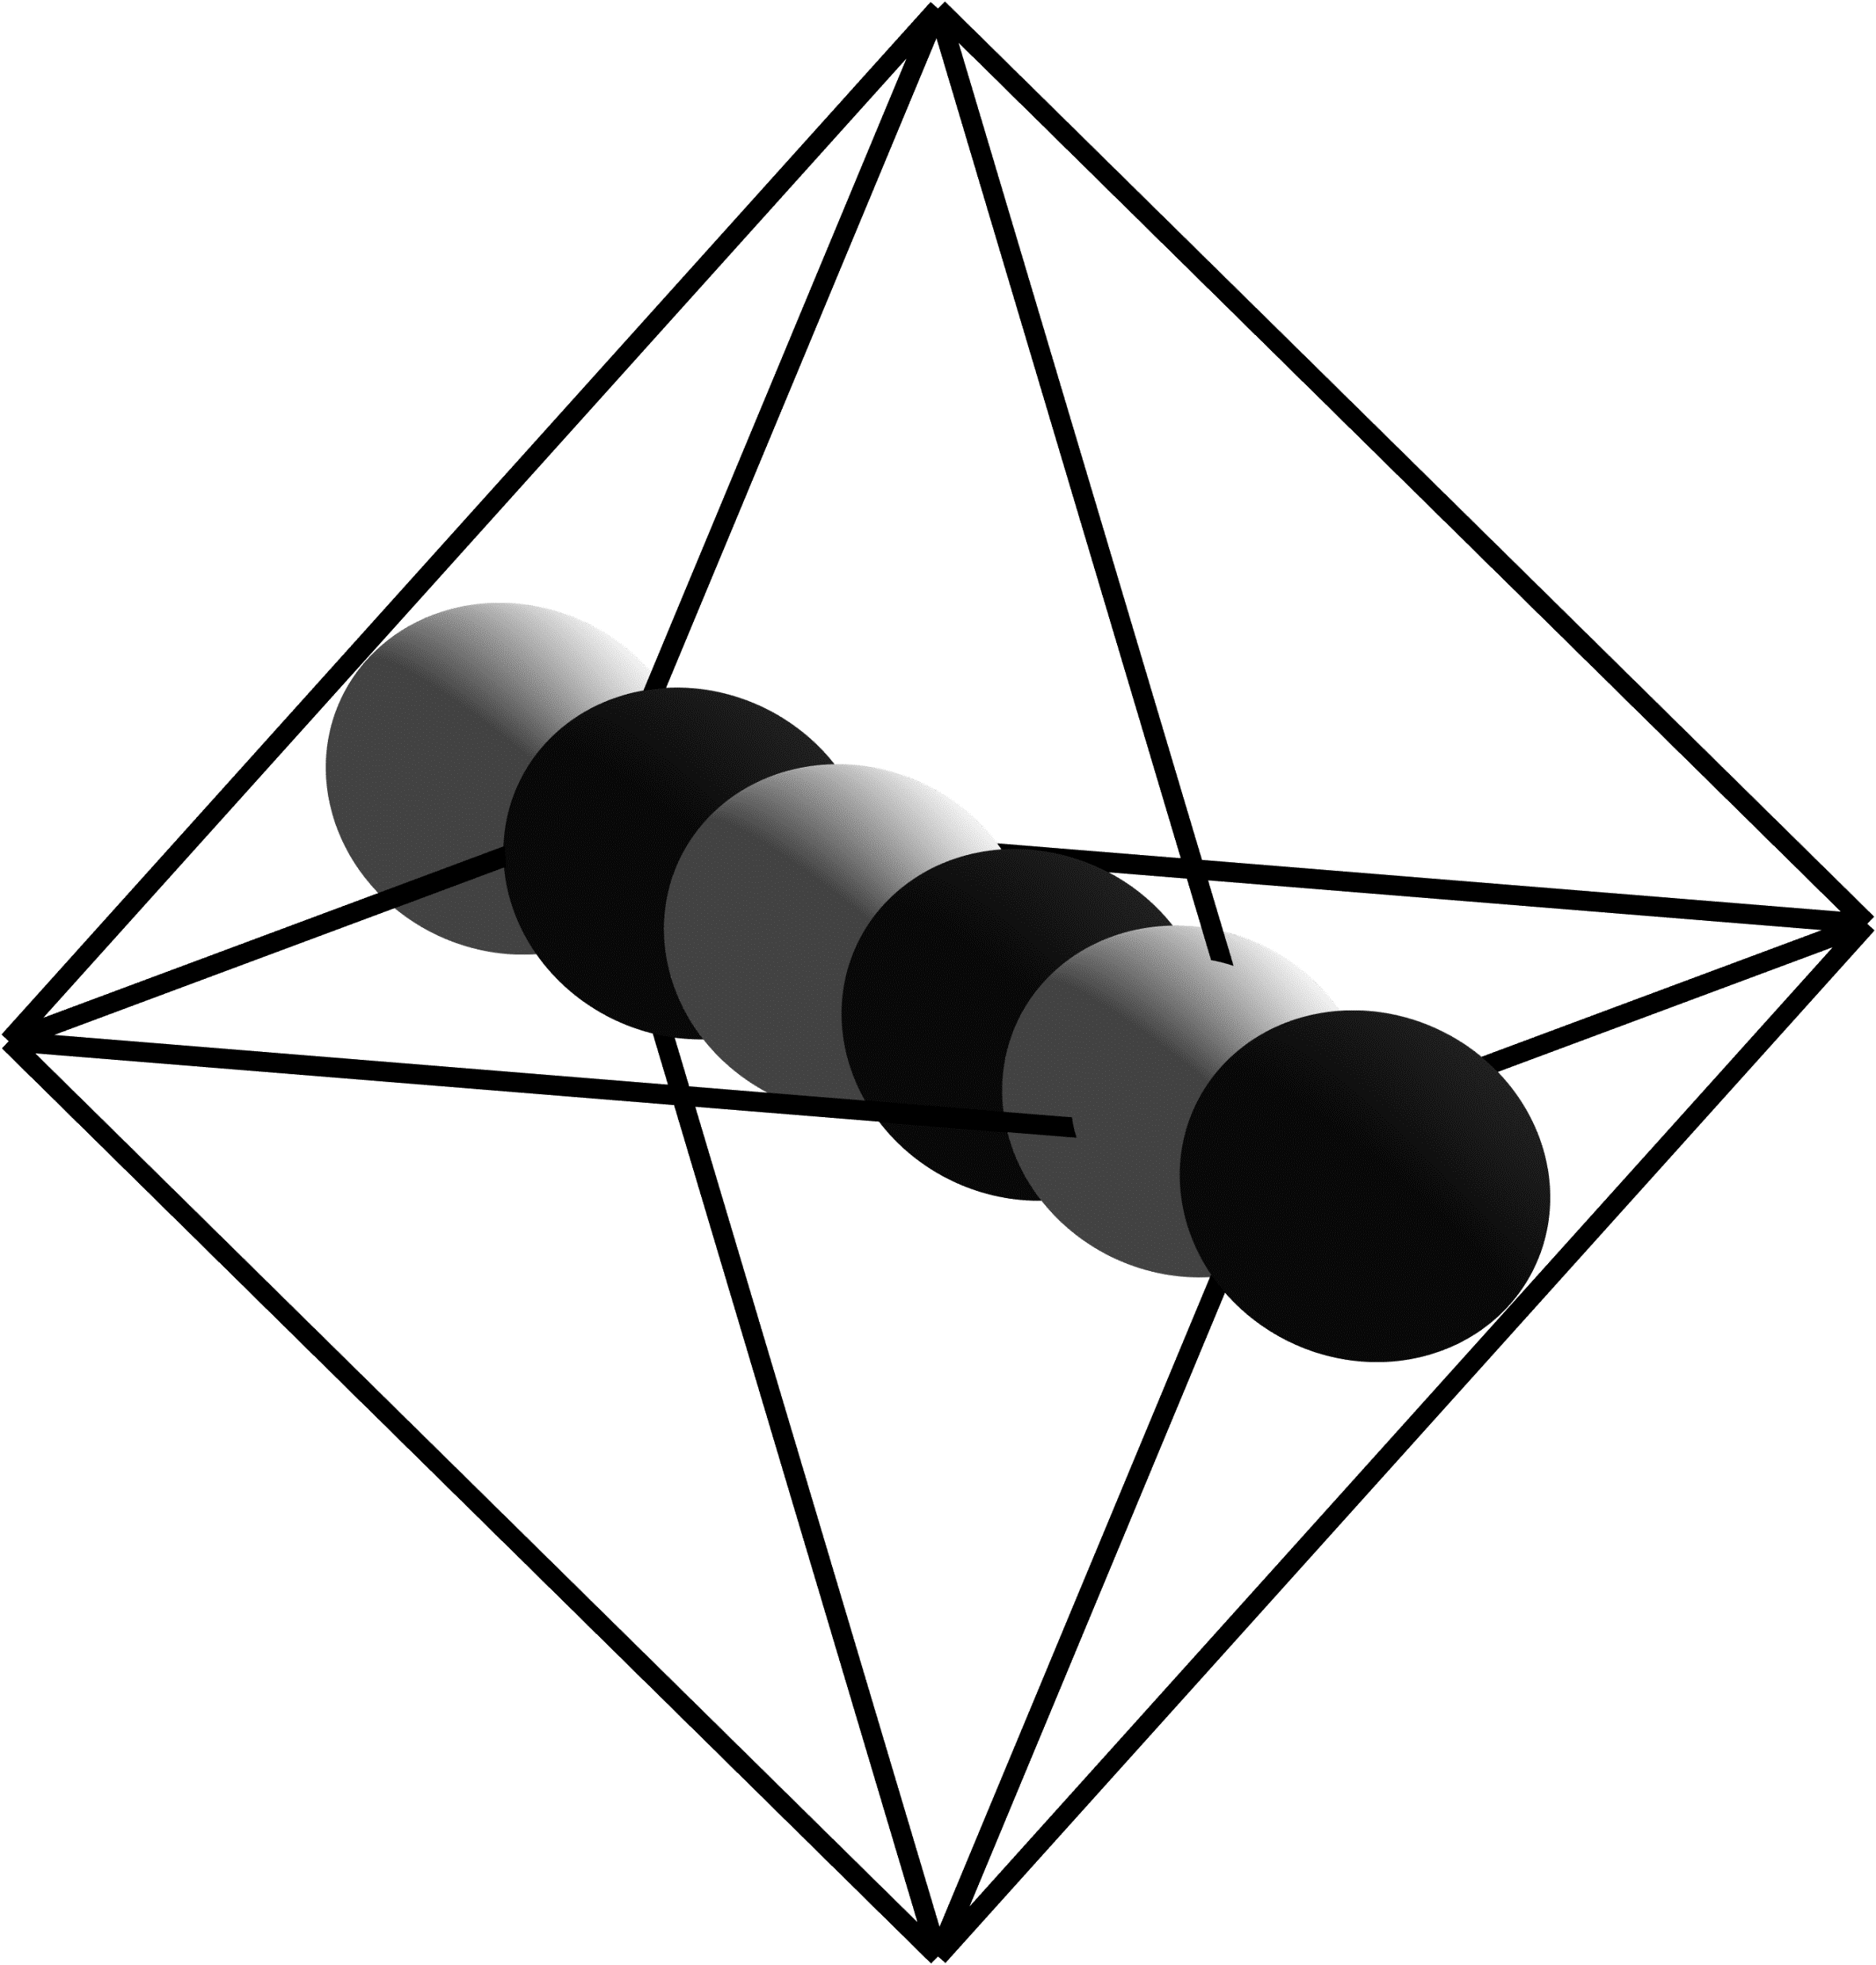

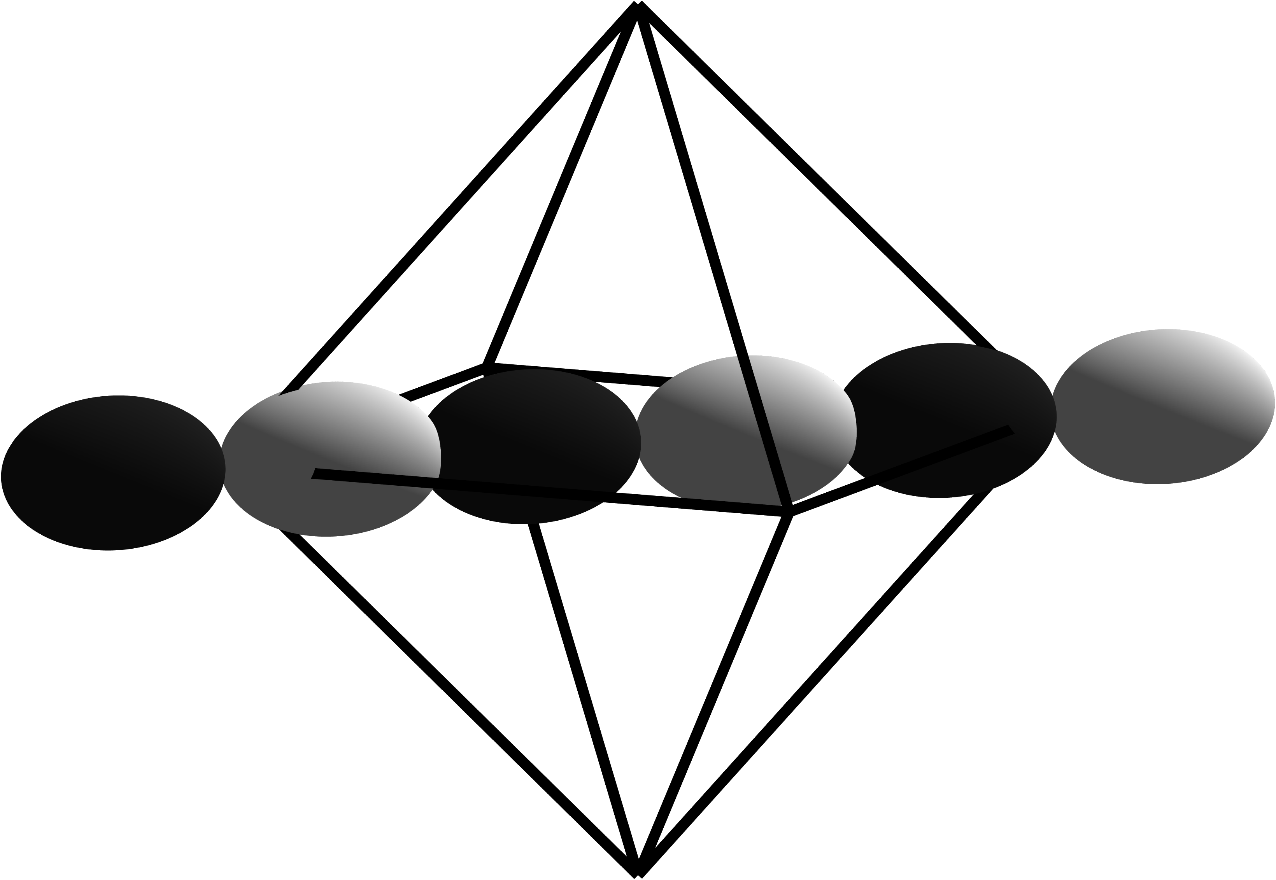
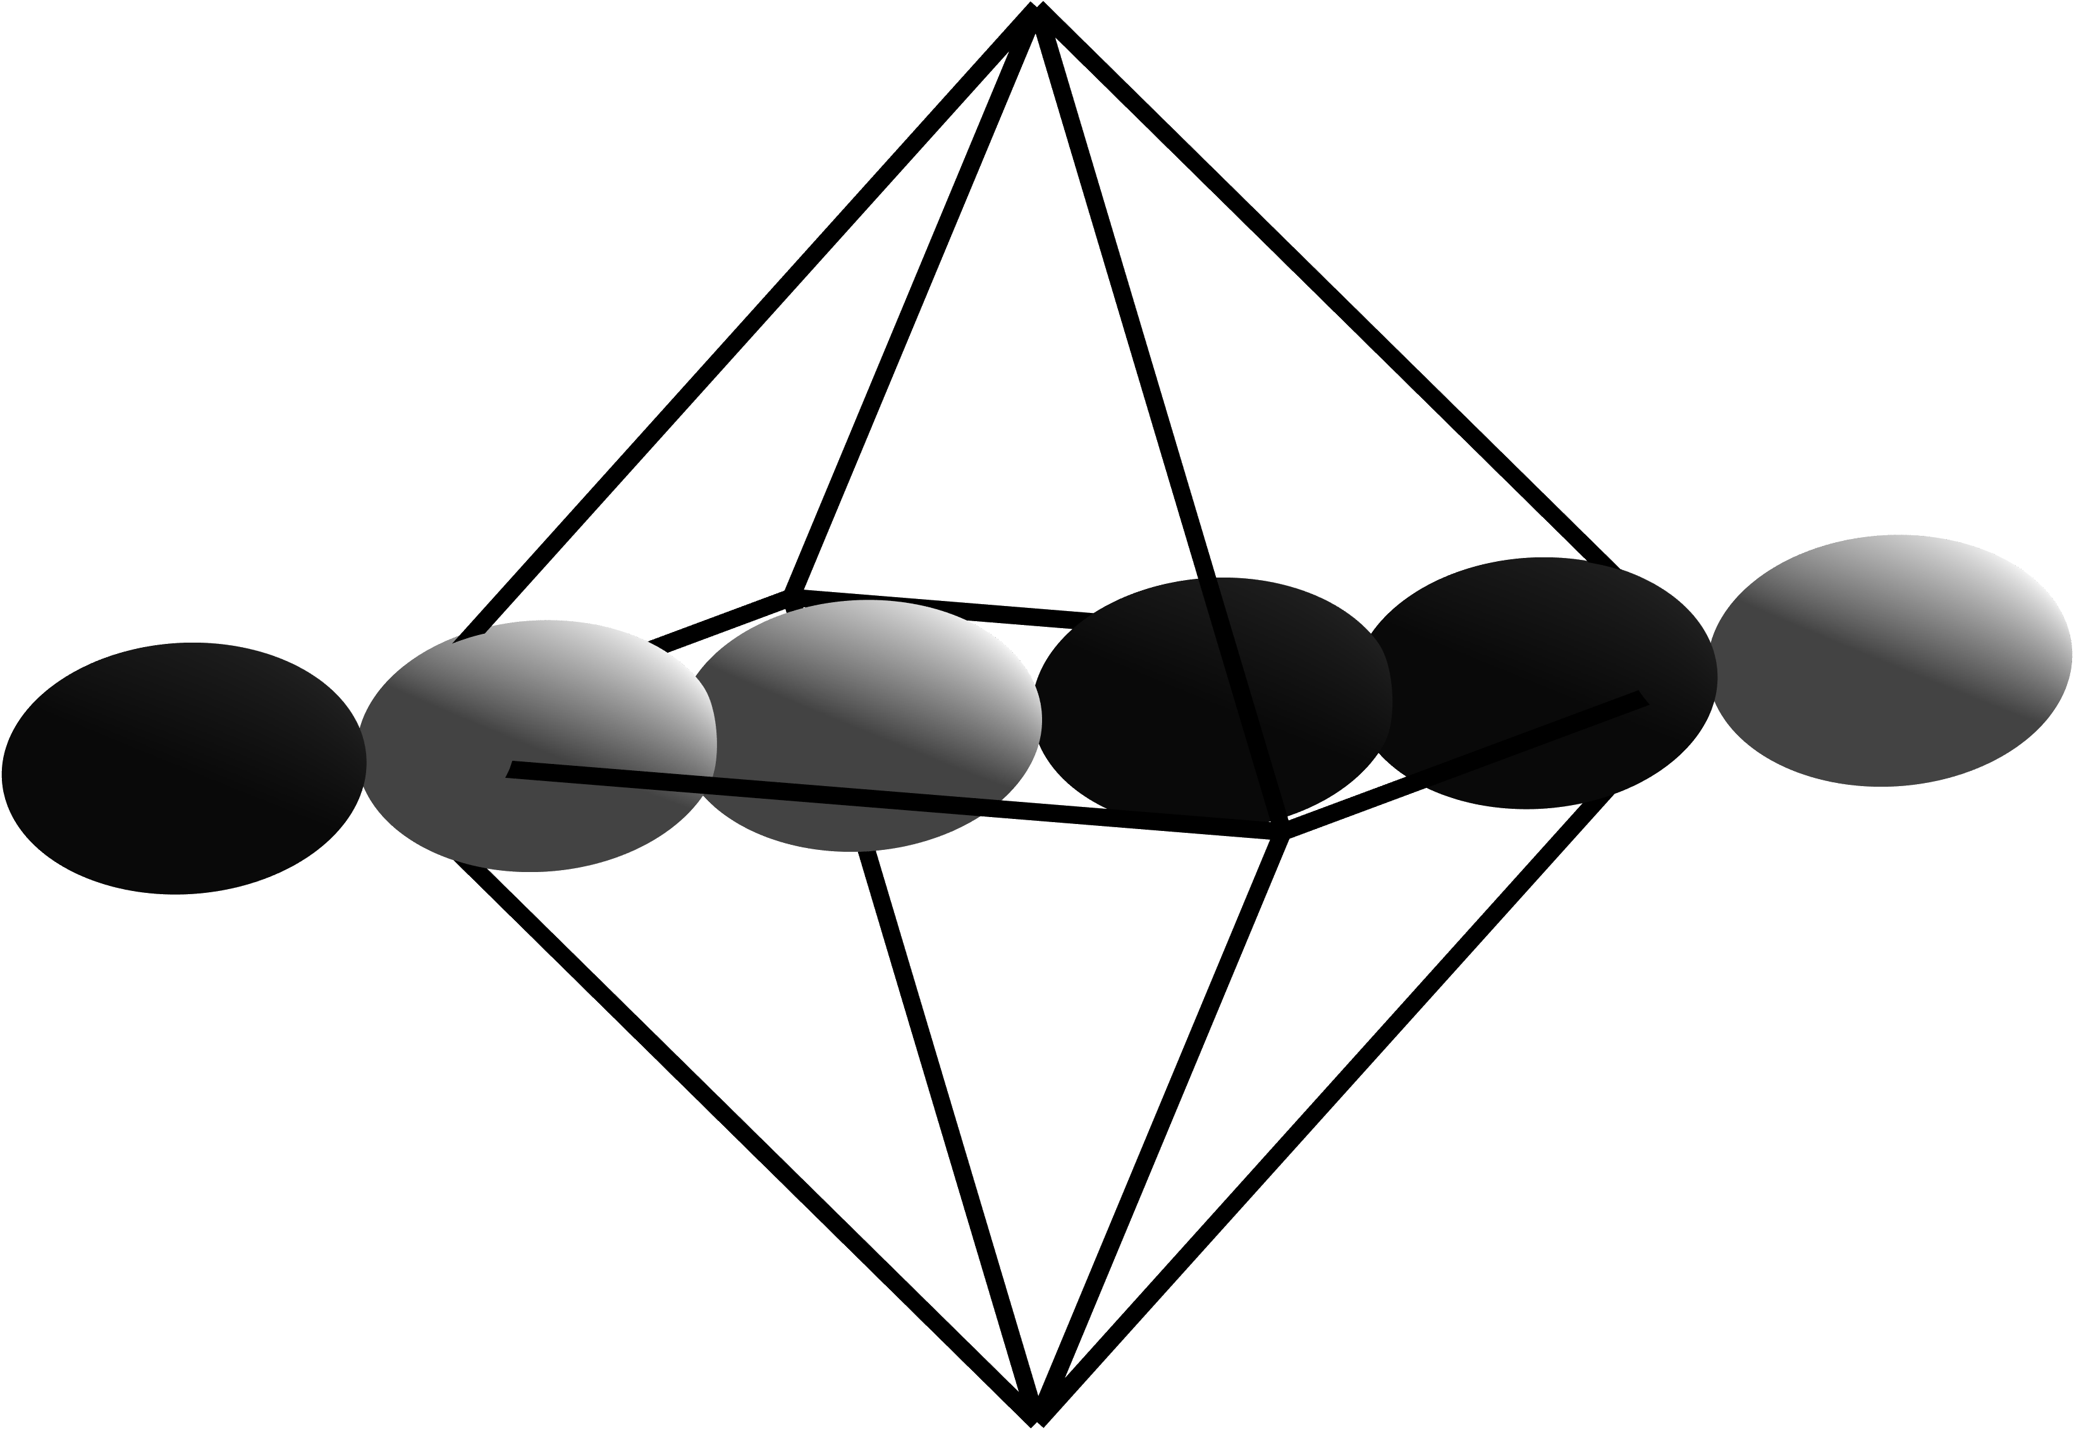
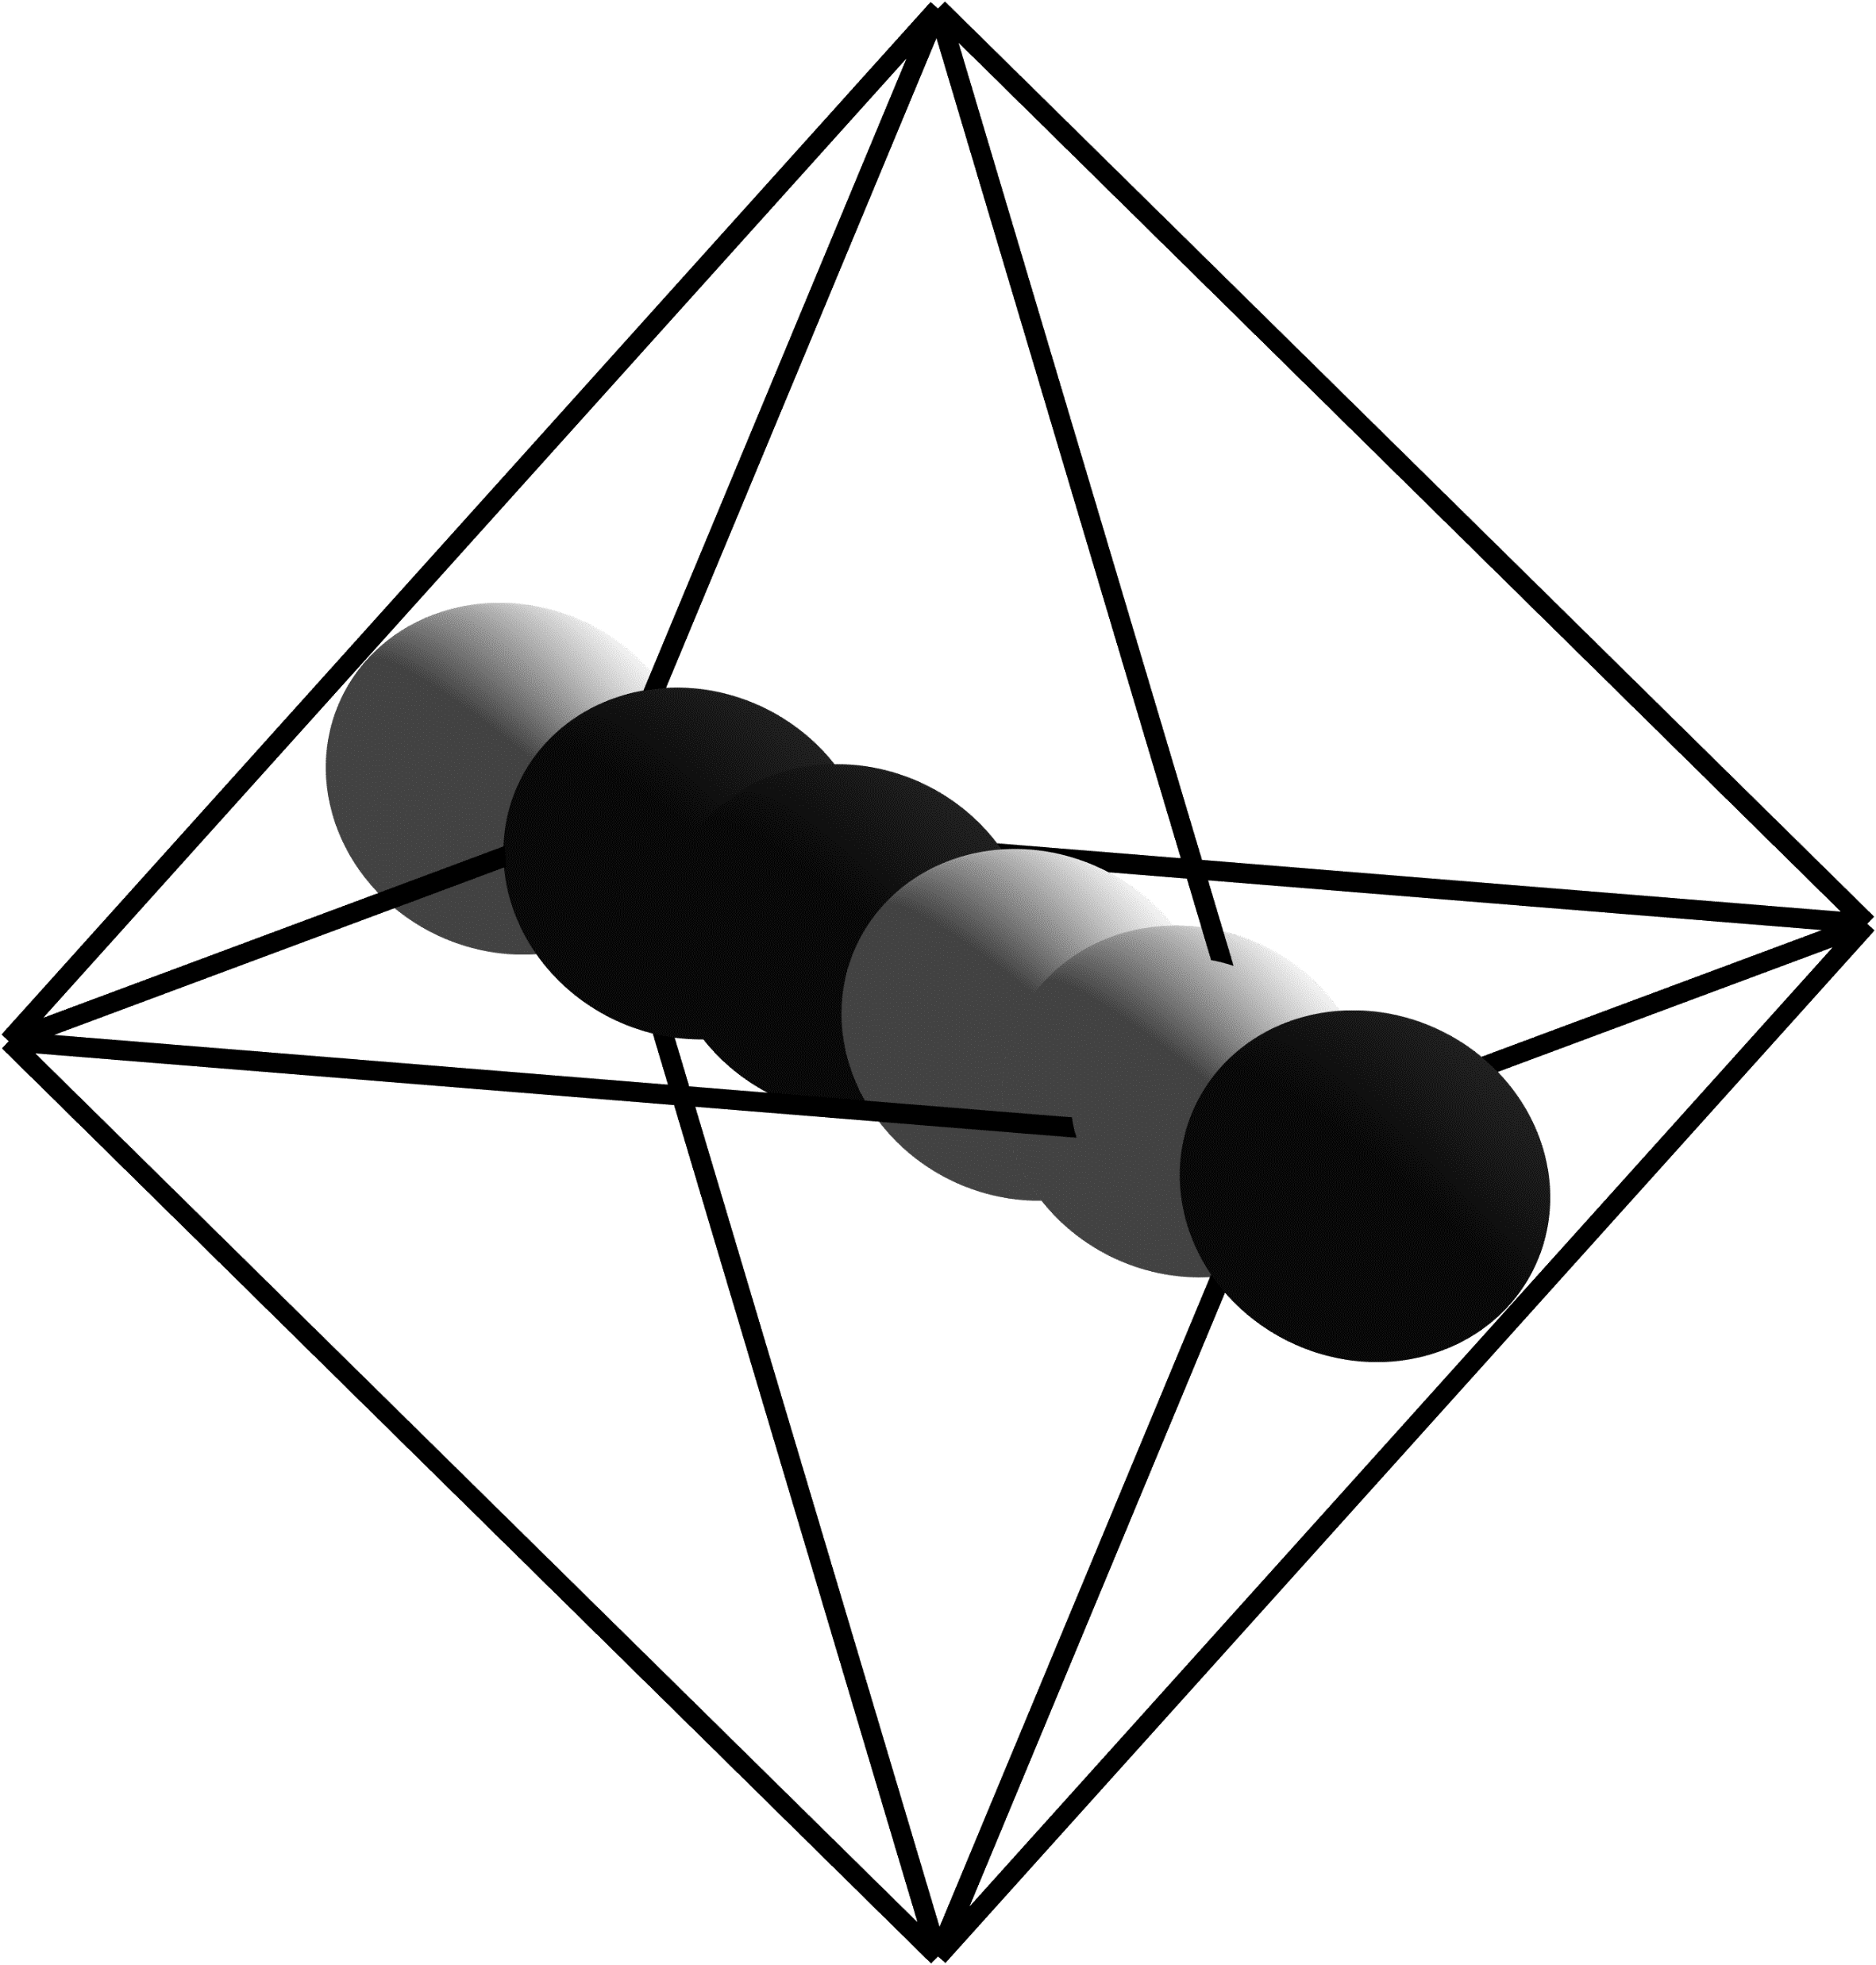

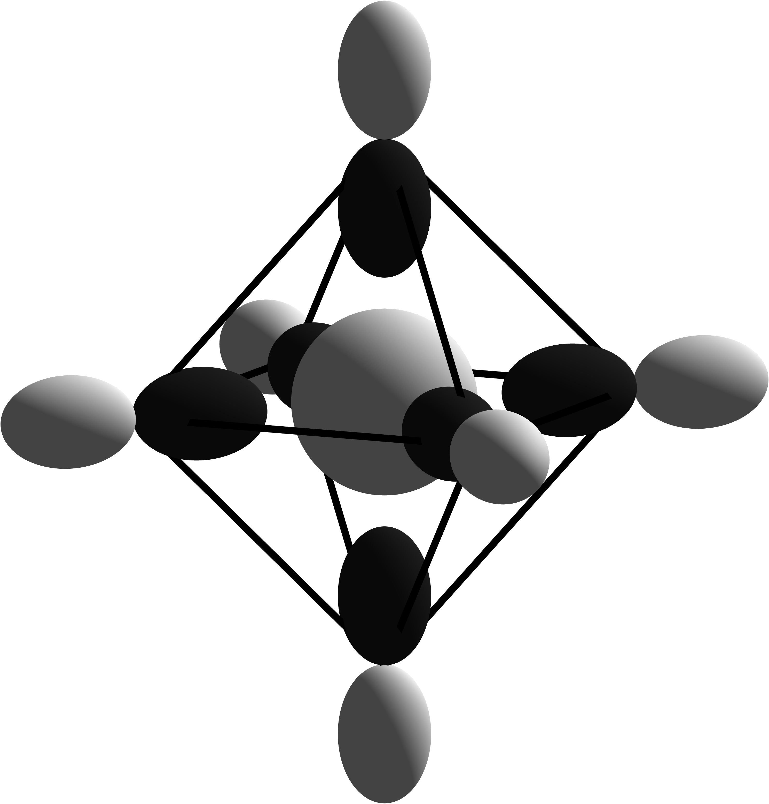
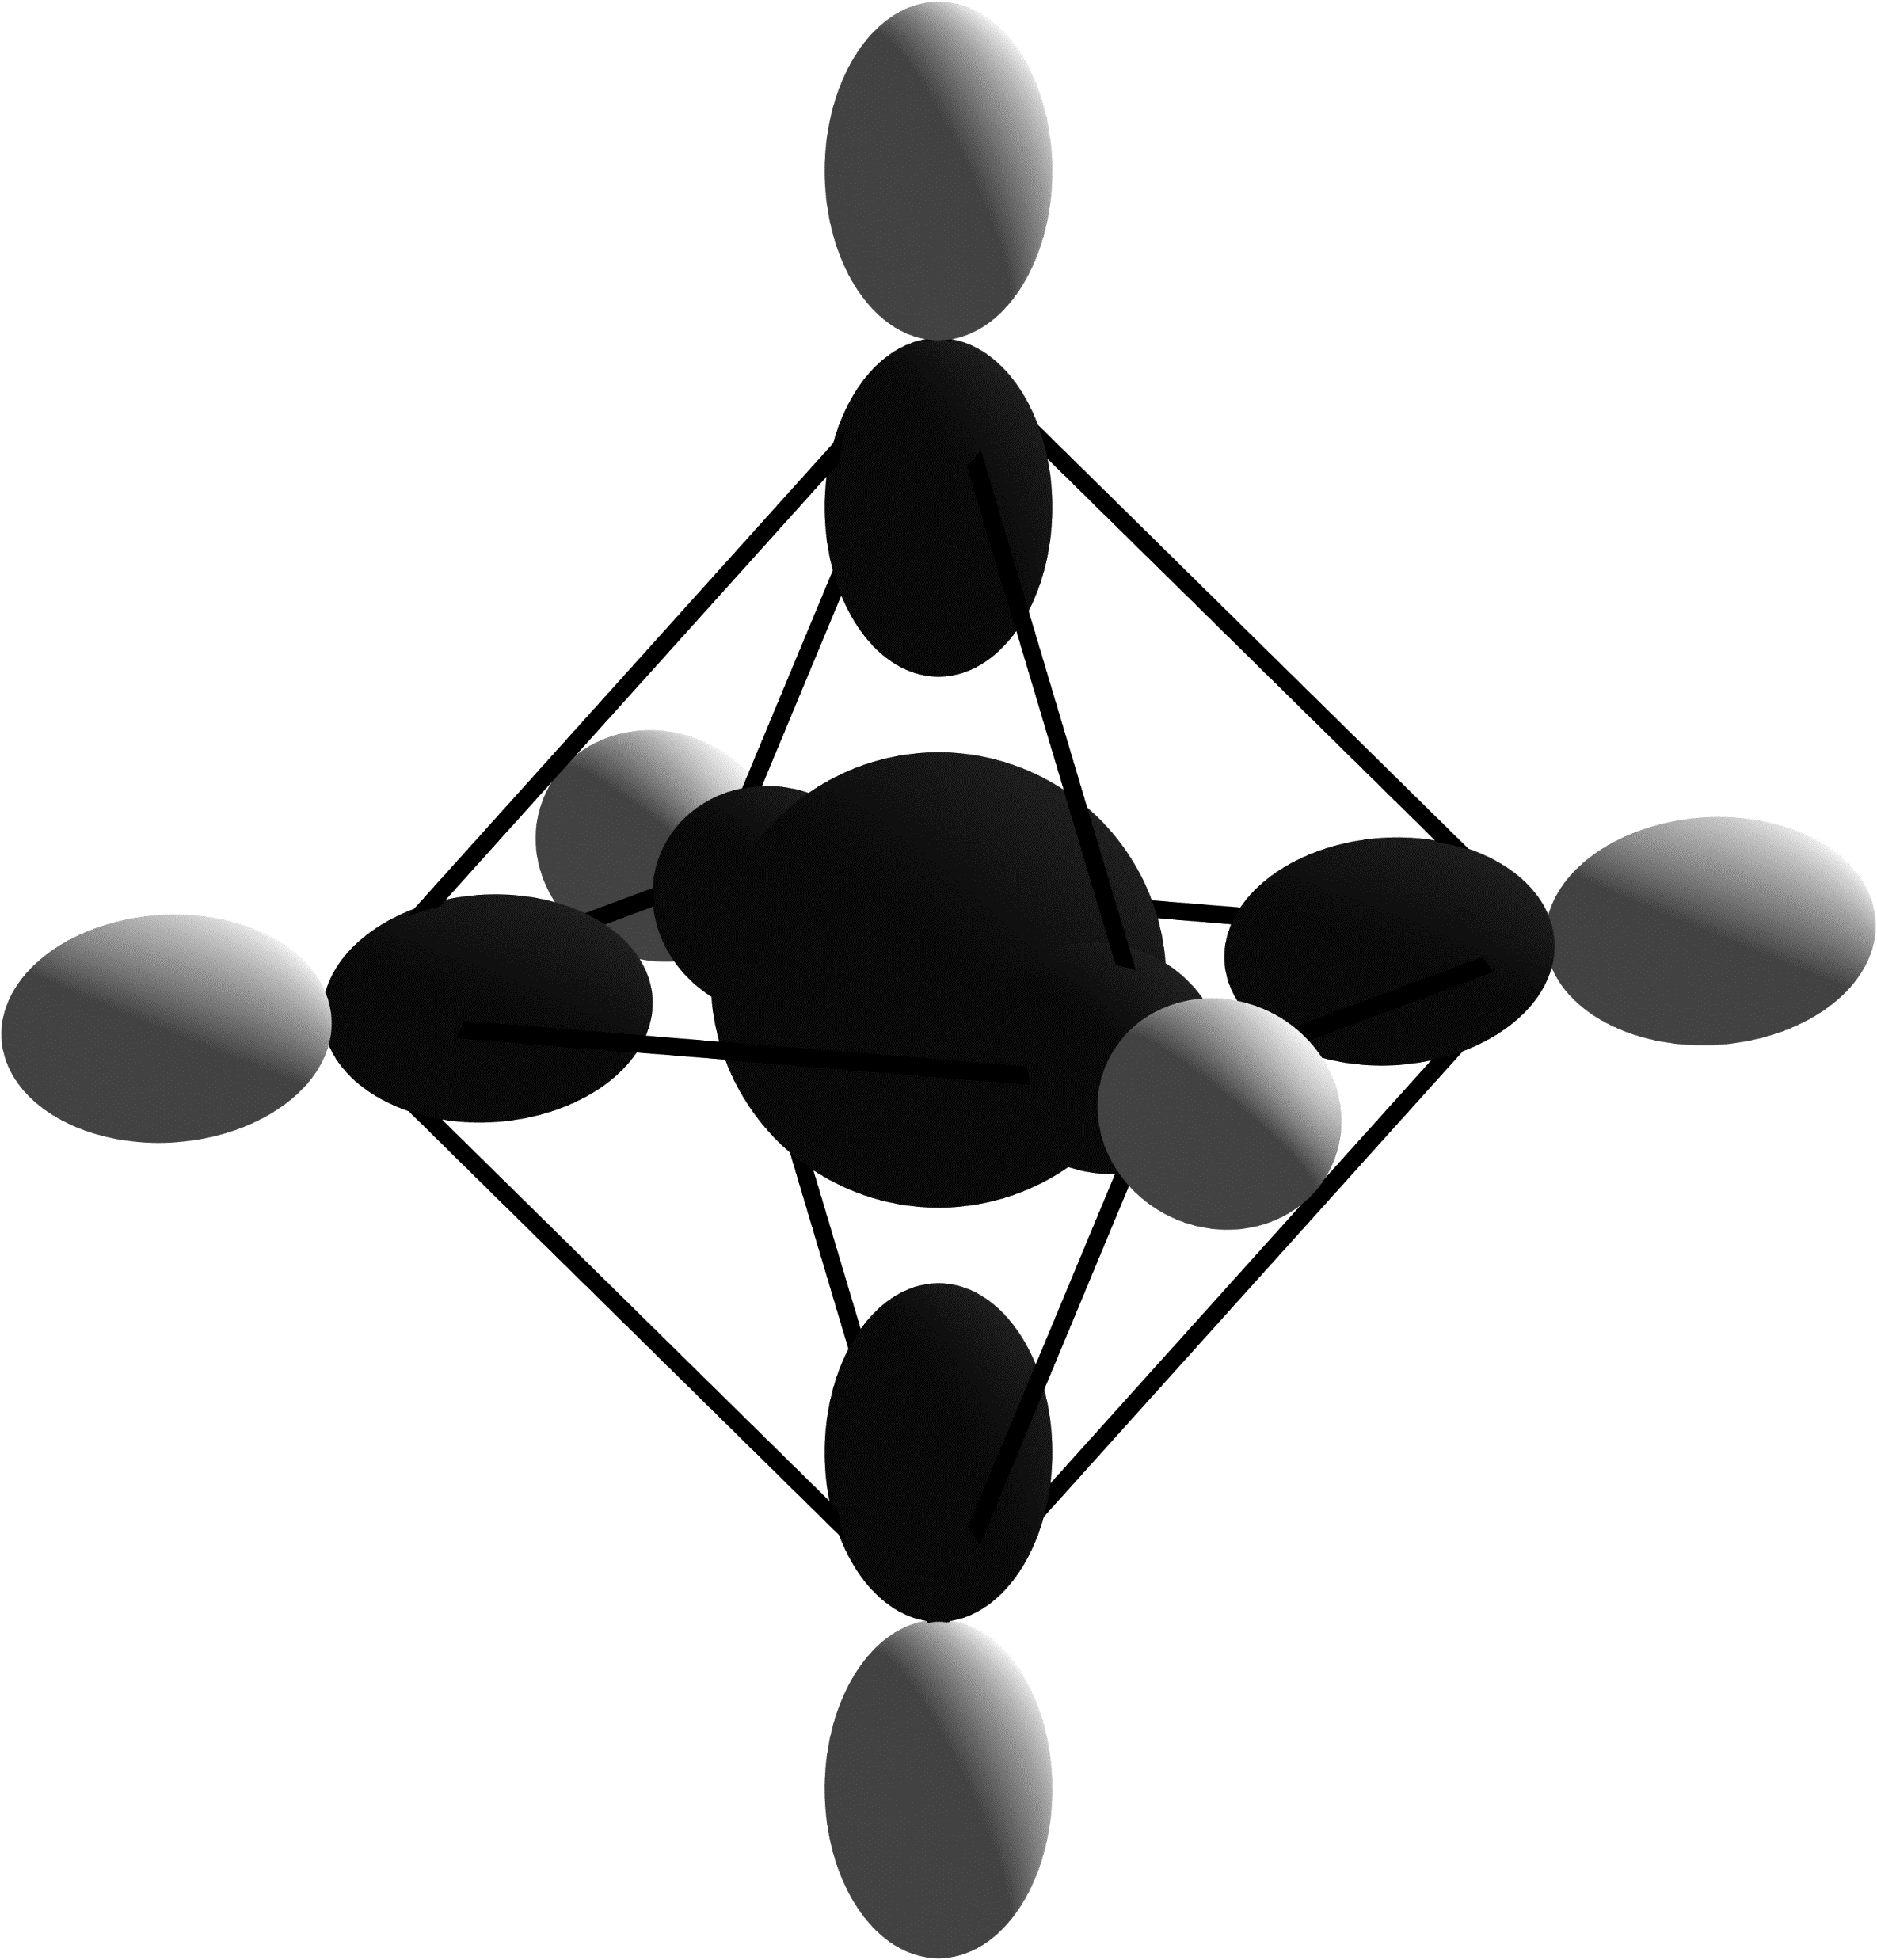
Conduction Band
E_{CBM}
E_{F}
E_{VBM}
Valence Band
T⁺
1
E⁺
T⁻
P
2
T⁻
1
T⁻
1
T⁺
2
A⁺
1
S
Notes:
Oxygen on Magnesium Site

Slide 4
Conduction Band
T₁
A₁
E_{CBM}
E_{F}
E_{VBM}
Valence Band
P
T₂
T₁
E
T₂
A₁
S
Notes:
Oxygen Interstitial

Slide 5
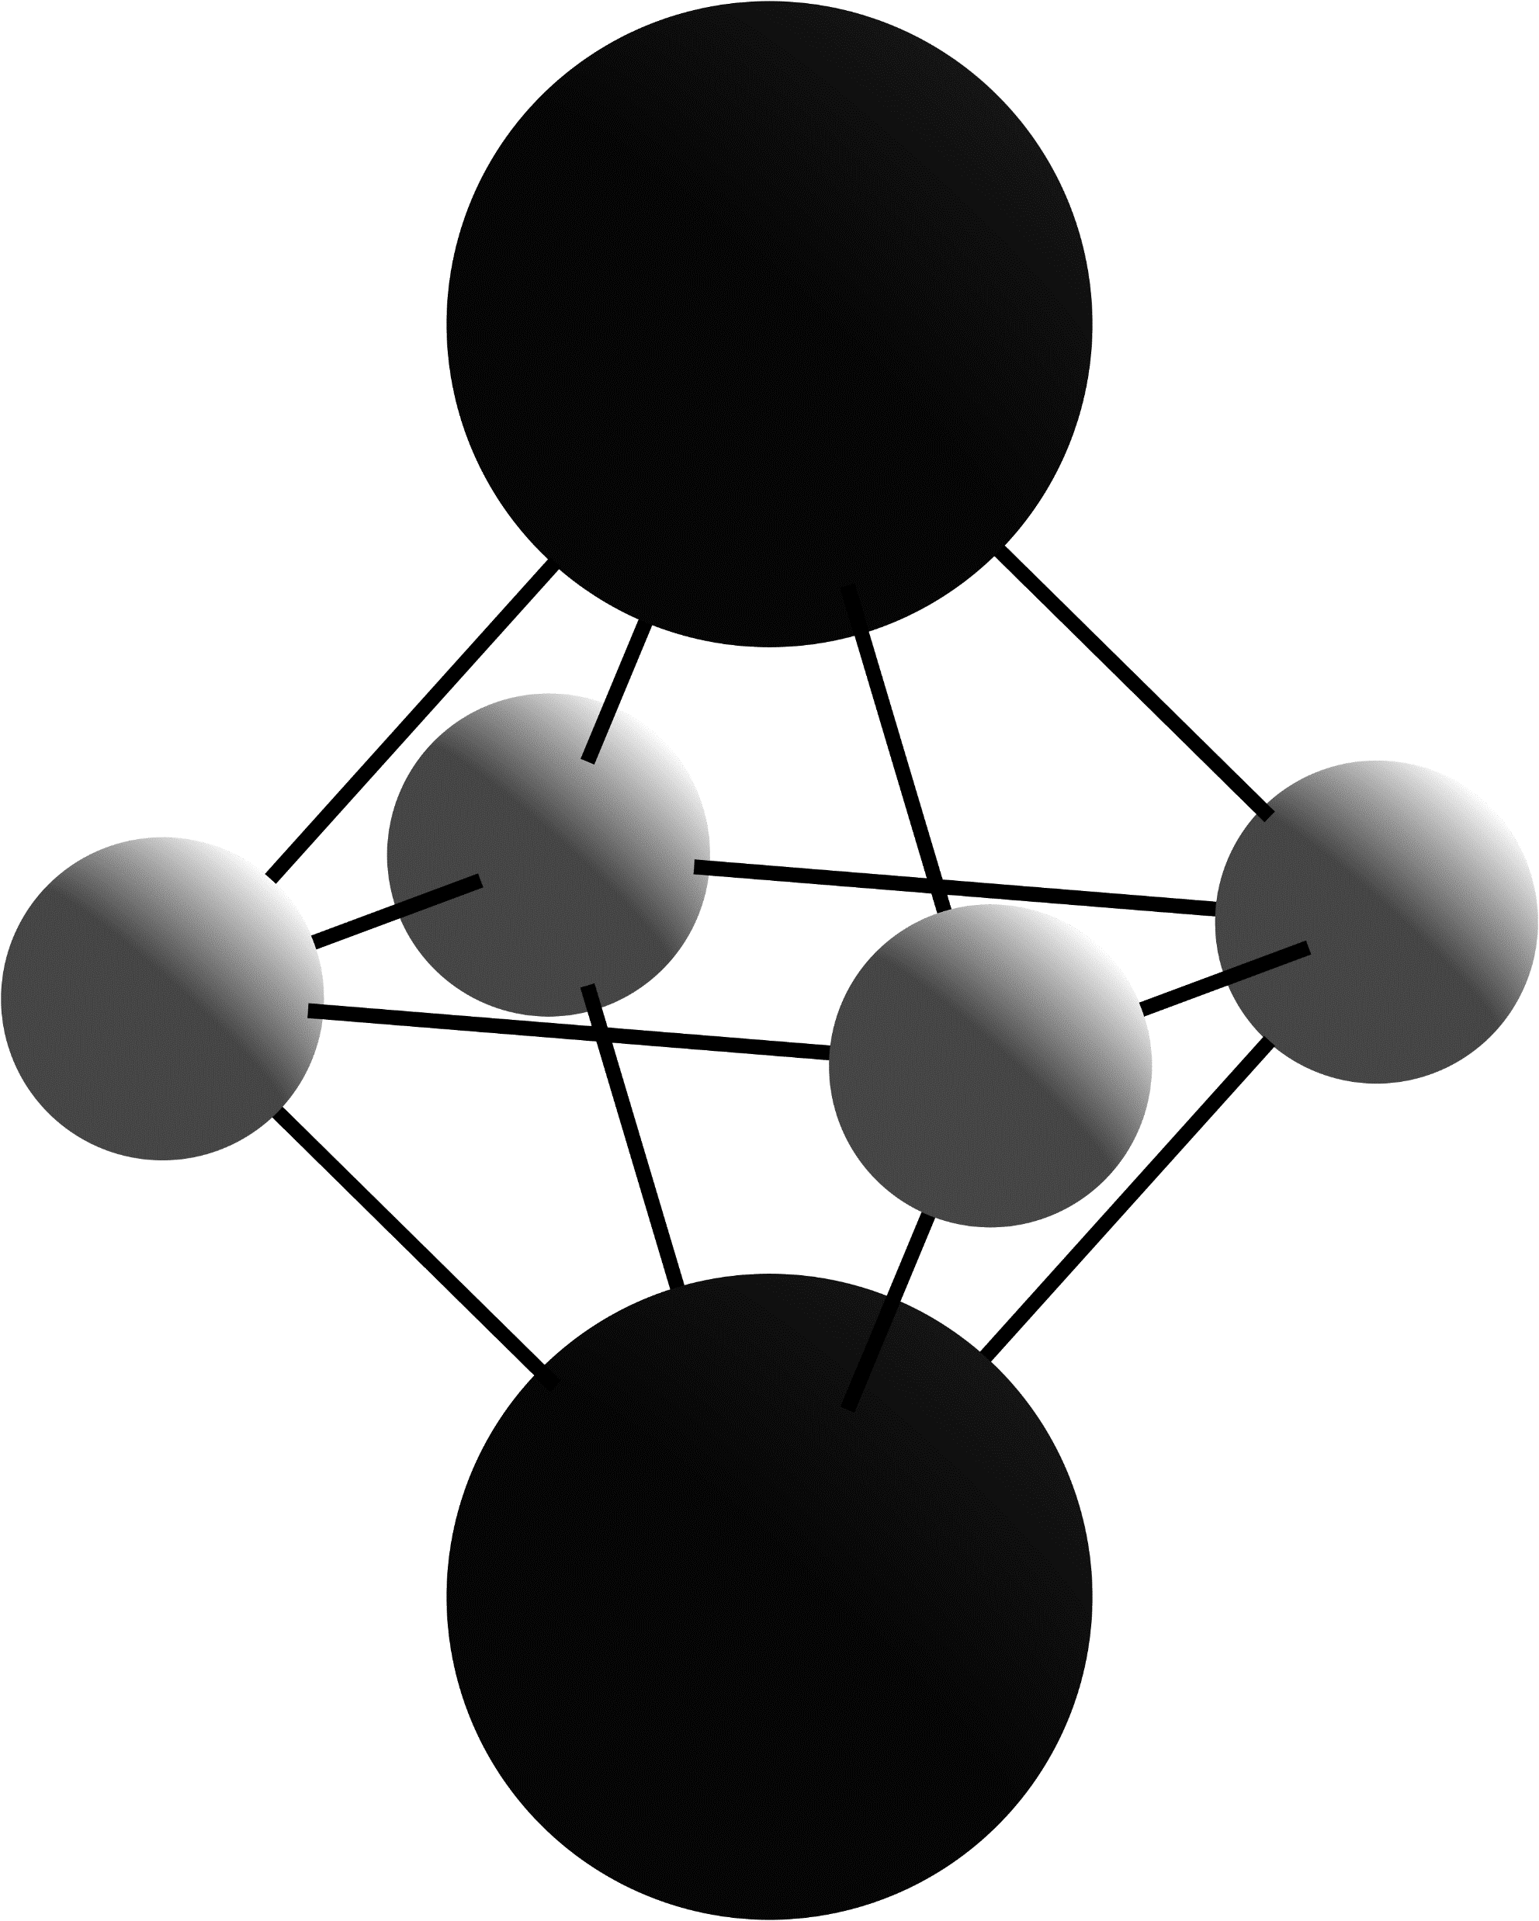
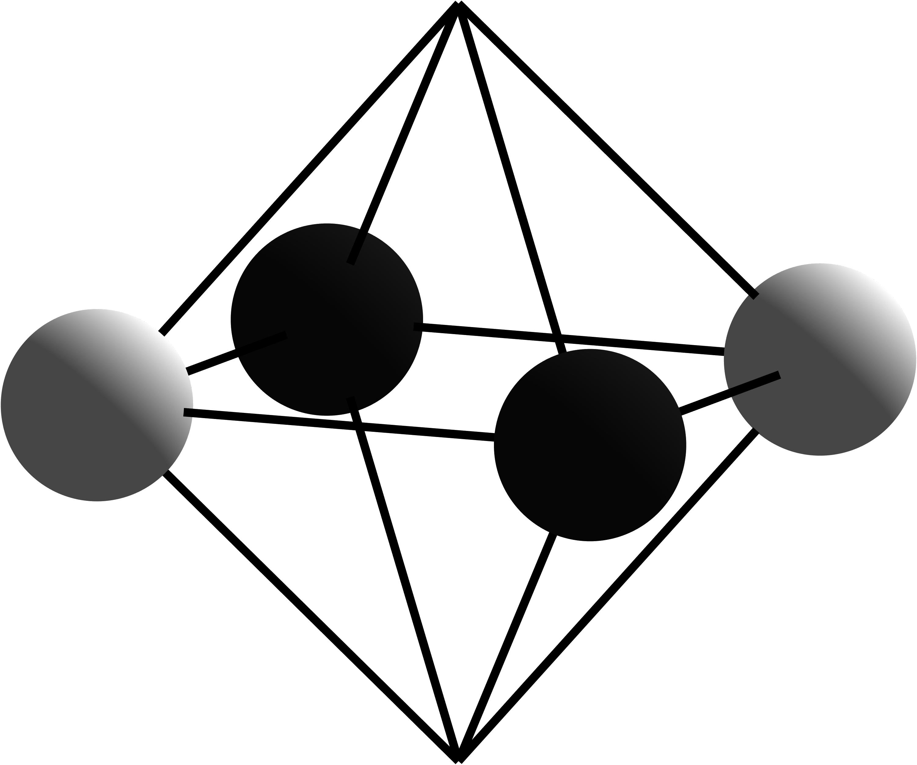
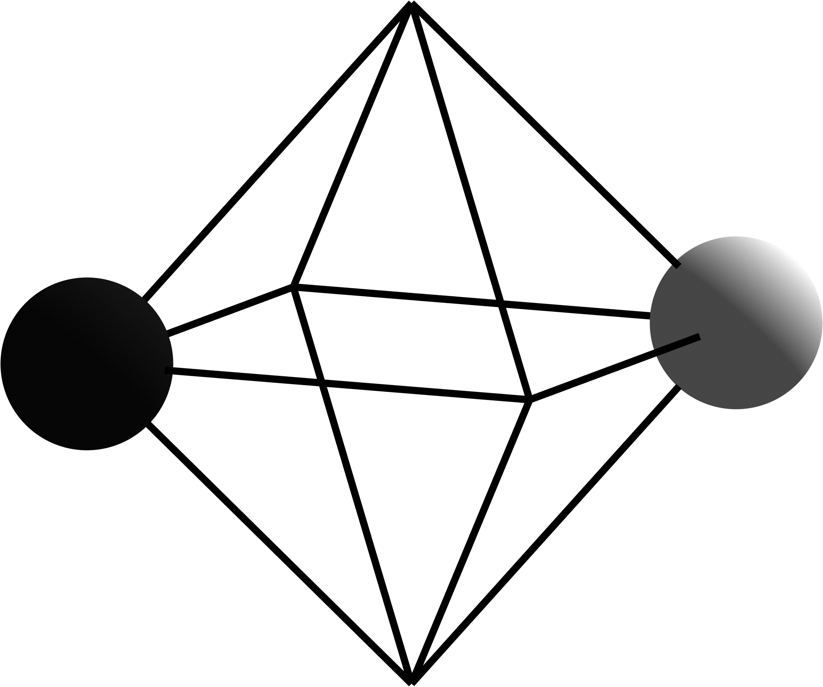
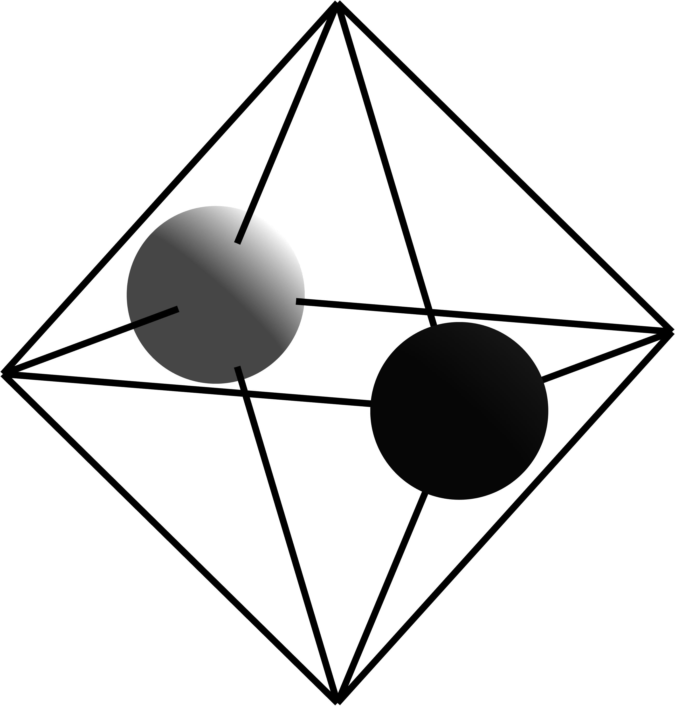

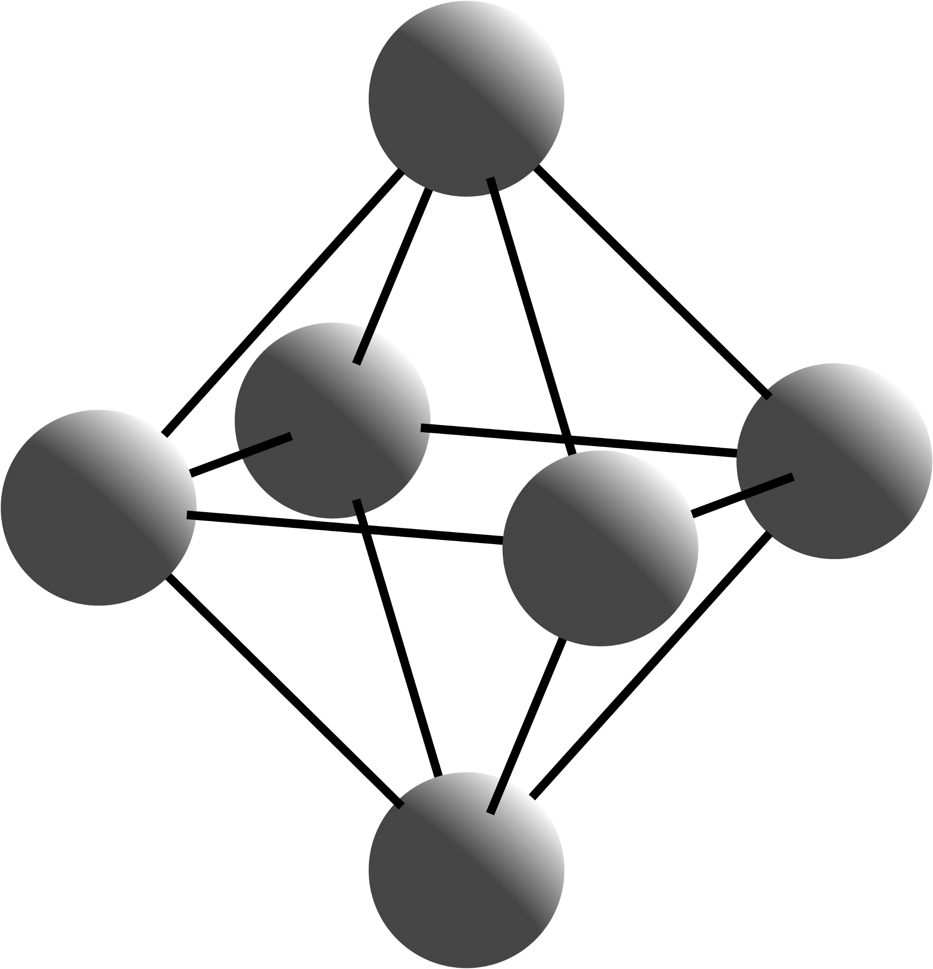
Conduction Band
E⁺
T⁻
1
A⁺
1
E_{CBM}
E_{F}
E_{VBM}
Valence Band
Notes:
Oxygen Vacancy

